Slide 1
Shaping the future of work through social dialogue
  Susan Hayter, Senior Technical Advisor, Future of Work, ILO

Slide 2
Introduction
  Social dialogue, defined as “all types of negotiation and consultation, and also the exchange of information between, or among, representatives of governments, employers and workers on issues of common interest relating to economic and social policy”
The important thing about @theglobaldeal is it doesn't just talk about social dialogue and collective bargaining, it acts to make sure they happen in workplaces around the world.
  Guy Ryder, Director General, ILO, February 2020

Slide 3
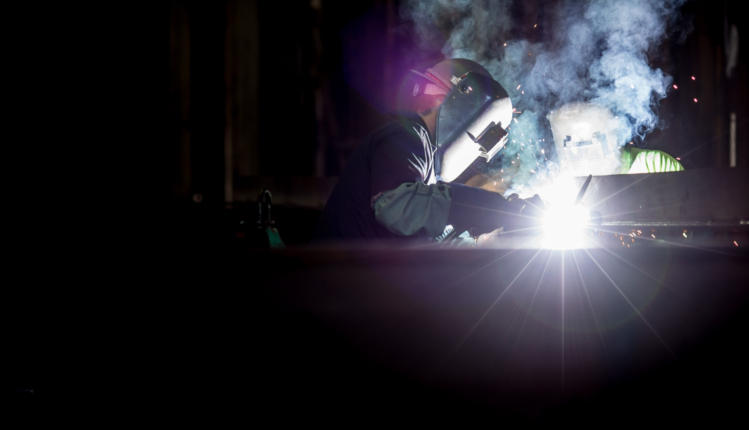
Facing the future of work
Transformative technologies
Global supply of goods and services
Transition to low carbon economy
Demographic shifts

Slide 4
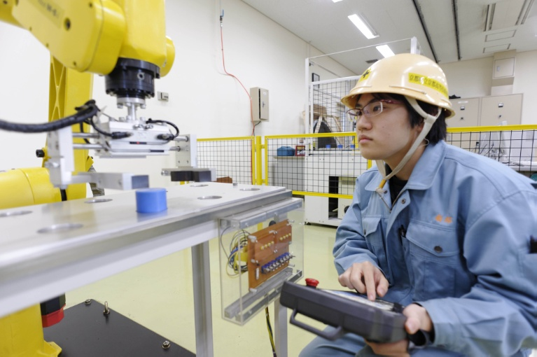
Shaping the future of work
Social dialogue for balanced adoption of transformative technologies
    Partnerships and dialogue on human-centred principles for digitalization
    Consultation and cooperation of industry transformation plans and technological transformation in the workplace
    Representation and bargaining for inclusive labour protection in the platform economy
    Negotiation of working-time arrangements

Slide 5
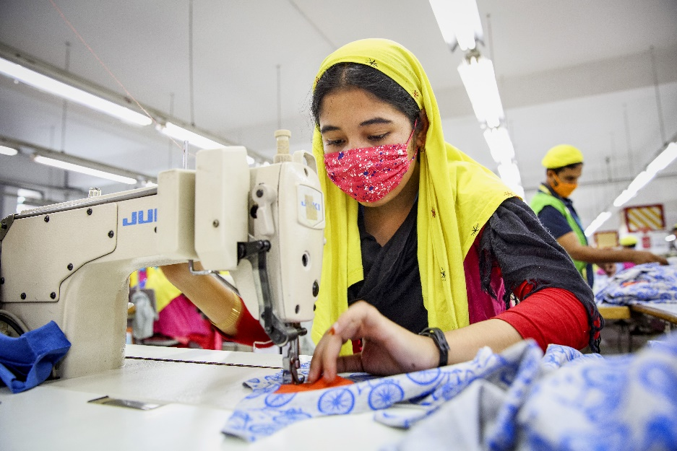
Shaping the future of work
Social dialogue to reinforce national governance in global supply chains
    Consultation and cooperation at the workplace to ensure OSH and improve productivity
    Social dialogue to enhance compliance and improve wages, working conditions and social protection
    Frameworks for social dialogue between MNEs and GUFs to promote respect for freedom of association at all levels

Slide 6
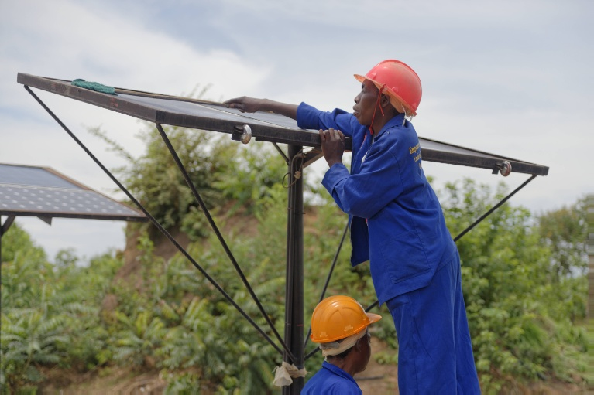
Shaping the future of work
Social dialogue for a just transition
    Tripartite social dialogue and consultation for a just transition
    Social dialogue to mitigate the effects of environmental degradation

Slide 7
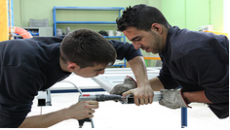
Shaping the future of work
Social dialogue and demographic change
    Social dialogue on active ageing
    Social dialogue on youth unemployment and apprenticeship systems
    Social dialogue and care workers

Slide 8

ILO Centenary Declaration for a Future of work
Strengthening the capacities of all people to benefit from the opportunities of a changing world of work
Strengthening the institutions of work to ensure adequate protection of all workers
Promoting sustained, inclusive and sustainable economic growth, full and productive employment and decent work for all

Slide 9

Thank you!
https://www.theglobaldeal.com/resources/

